Slide 1

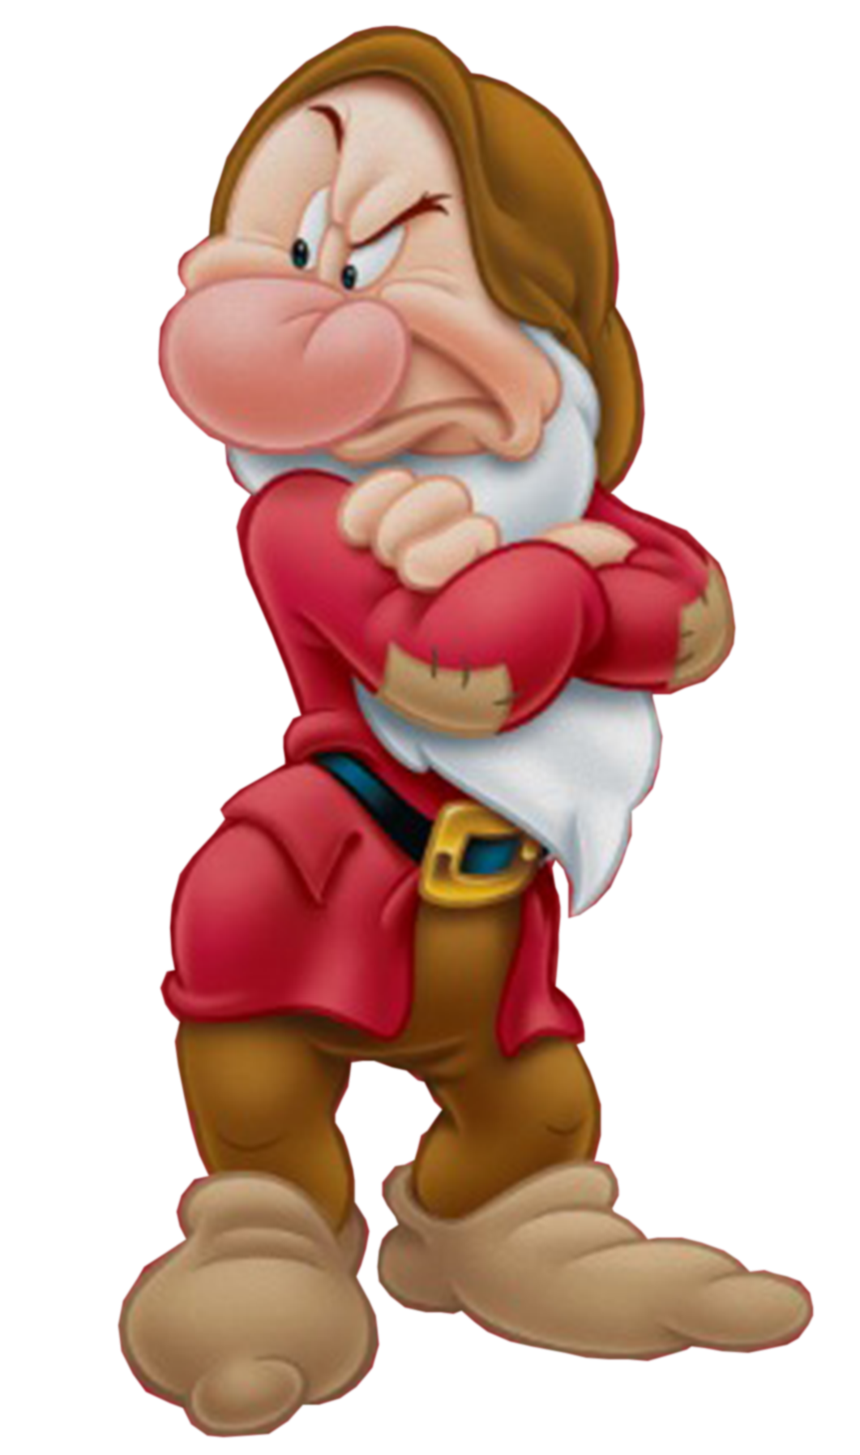

“Grumpy” Does Not Equal “Mean”:
Assessing Irritable Mood and Hurtful Behaviors during Early Childhood
Martha Karran, Jennifer Valad, Gabriela Ventura, Jeffrey M. Halperin
Queens College, City University of New York
Abstract
Descriptive Characteristics at each Time-point
Objective: The present study assessed the extent to which irritable mood and hurtful behaviors can be differentially measured in early childhood and the stability of these two constructs over time. Methods: Preschoolers (N = 214; 3-4 years old) were evaluated by their parents on a broad spectrum of psychopathology at baseline (T1). Identical measures were collected annually for two years (T2 and T3). Items from the Behavior Assessment System for Children, Second Edition (BASC-2) that seemed to represent the constructs of irritability and hurtful behaviors were selected. Results: Using a principal components analysis with varimax rotation, two factors were extracted at each time-point representing separable Irritable and Hurtful dimensions. Cronbach’s alphas indicated that each subscale was reliable. Irritability scores at T1 were highly correlated with Irritability scores at T2 and T3, and Irritability scores at T2 and T3 were highly inter-correlated. Similarly, Hurtful scores at T1 were correlated with Hurtful scores at T2 and T3, and Hurtful scores at T2 and T3 were inter-correlated. In contrast, Pearson correlation coefficients between Irritability and Hurtful scores, concurrently and over time, were substantially lower. Conclusions: These data indicate that irritable mood can be clearly identified in early childhood and is a highly stable trait that is largely distinct from the hurtful behaviors often seen in young children. Future research will examine the degree to which high levels of irritable mood and hurtful behaviors during the preschool years differentially predict psychiatric outcomes during the school-age years.
 | T1 | T2 | T3
N | 214 | 184 | 173
Mean Age (SD) | 3.78 (0.47) | 4.75 (0.43) | 5.81 (0.47)
Males | 73.36% | 70.65% | 73.41%
T1
T2
T3
Comparisons
Results
Principal Components Analyses
Descriptive Statistics
T1
T2
T3
 | Irritability | Hurtfulness
Argues when denied own way | .624 | -.077
Loses temper easily | .825 | .202
Is easily upset | .722 | .217
Throws tantrums | .702 | .308
Is easily soothed when angry | .583 | -.061
Annoys others on purpose | .461 | .352
Is easily annoyed by others | .605 | .487
Breaks other children’s things | .033 | .550
Calls other children names | -.164 | .444
Threatens to hurt others | .323 | .645
Bullies others | .293 | .665
Teases others | .194 | .746
 | Irritability | Hurtfulness
Argues when denied own way | .710 | .088
Threatens to hurt others | .489 | .152
Loses temper too easily | .856 | .114
Is easily upset | .789 | .085
Throws tantrums | .713 | .287
Is easily annoyed by others | .654 | .291
Is easily soothed when angry | .635 | .117
Annoys others on purpose | .337 | .592
Breaks other children’s things | .062 | .545
Calls other children names | .054 | .492
Bullies others | .276 | .690
Teases others | .115 | .794
 | Irritability | Hurtfulness
Argues when denied own way | .742 | -.063
Threatens to hurt others | .537 | .301
Loses temper too easily | .842 | .087
Is easily upset | .768 | .175
Is easily annoyed by others | .716 | .372
Is easily soothed when angry | .528 | .254
Breaks other children’s things | - | -
Annoys others on purpose | .554 | .442
Throws tantrums | - | -
Calls other children names | .004 | .764
Bullies others | .180 | .672
Teases others | .280 | .754
 | Time-point | Mean Score (SD)
Irritability | T1 | 6.45 (3.04)
 | T2 | 6.79 (3.87)
 | T3 | 5.85 (3.40)
Hurtfulness | T1 | 2.34 (2.17)
 | T2 | 1.81 (1.80)
 | T3 | 1.37 (1.44)
Background
Recent studies of school-aged children have begun to separate the construct of “irritability” from that of “headstrong” or “defiant” (Whelan et al., 2013).
Data from these studies suggest that irritability is associated with internalizing disorders (e.g., depression) in adolescence and adulthood, whereas headstrong/defiant is more closely linked to later externalizing or antisocial difficulties (Whelan et al., 2013; Dougherty et al. 2013).
Althoff et al. (2014) used items from the Child Behavior Checklist (CBCL) to derive subscales to assess irritability in school-age children and adolescents.
The present study looked at similar constructs, termed “Irritability” and “Hurtfulness,” in early childhood, using items from the BASC-2.
We hypothesized that these items would separate into two factors representing Irritability and Hurtfulness and that Pearson correlations would indicate stability over time.
Correlations
Differential Stability Over Time
Irritability and Hurtfulness (Concurrent)
Irritability and Hurtfulness (Over Time)
Irritability
Hurtfulness
Pearson Correlation (r)
Methods
* Results significant at the p < .01 level
Summary and Conclusions
The sample was derived from the Queens College Preschool Project (QCPP) – a longitudinal study investigating ADHD.
Participants were recruited at age 3-4 and were re-evaluated annually.
As a part of the annual evaluation, parents completed the BASC-2.
The present study encompasses three years: baseline (T1), the first annual follow-up (T2), and the second annual follow-up (T3).
The present study assessed irritable mood and hurtful behaviors in early childhood.
These data show that the constructs of Irritability and Hurtfulness are distinct and demonstrate stability over time.
Consistent with previous research (Dougherty et al., 2013), these findings indicate that irritability at 3-4 years old is associated with irritability 2 years later.
Future research will examine the extent to which irritable mood and hurtful behaviors in early childhood differentially predict outcomes in school-age children.
Funding
This research was supported by grant # R01 MH068286 from NIMH.

